Slide 1
Strength Training Impact on Patients Suffering from Acute and Chronic Stroke
Name:
University
Spring 2021
Professor:
Course:

Slide 2
Introduction
Stroke is neurological loss caused by abnormal brain tissue perfusion.
Acute chronic stroke is one among subarachnoid hemorrhages, ischemic, and intracerebral hemorrhages.
Hypertension, diabetes mellitus, sleep apnea, atrial fibrillation, elevated triglycerides, an insufficient diet, tobacco consumption, and family history genetics, gender, physical inactivity, atherosclerosis, and chronic kidney diseases are health issues that arise from stroke.
Stroke is estimatto ed to affect 3.45 million individuals adults by 2030.
Stroke is estimated have caused 5% of deaths is 2013
Does strength training improve the health of acute and chronic stroke?

Slide 3
Literature Review
Stroke occurs when the brain tissue is cut off or when capillaries in the brain burst (El-Nashar et al 2019) .
Acute stroke symptoms are:
persistent musculoskeletal adaptations, contractures, and hemiparesis.
Patients with stroke have typically engaged in mild fitness prograns with a focus on inhibiting irregular muscle tone while facilitating regular activity habits.
Persons who have suffered a stroke will undergo extensive muscle strengthening whilst not experiencing an uptick in spasticity (Patten et al, 2004, p.6).
Muscle strengthening in stroke rehabilitation illustrate critical link between muscle strength training and stroke on patients.
There are significant associations occur among non-paretic Lower Extremity muscle robustness, gait, and stair ascending tasks

Slide 4
Muscle Strength Deficit Patterns
Muscle power varies after a strokesit is poion- dependent, volume-dependent, and time-dependent (Eng et al, (2004).
Distal muscles on the paretic region possess larger power deficiencies than proximal tissues.
The functional pairing of the cortical electroencephalogram (EEG), and muscle electromyogram may be used to determine cortical regulation of muscle movement( EEG).
Distal upper extremity (UE) muscles ultimately exhibit decreased EEG-EMG cohesion.

Slide 5
Muscle Strength Quantification in Acute Chronic Stroke
Referring patients to suitable exercises muscle strength measurement, entails the use of physical force by the tester and the meadurement has zero degrees of calibration (Eng, 2004).
Measures of power can be achieved through using hand-grip, isokinetic dynamometers, and hand-held (Muir (2001).
In grade 5/5 of the left knee extensor tear for 25% of the lateral meniscus, the expected level of joint motion is 52.6% - 33.2% at medium joint range for orthopedic surgeons and 64.2 percent (41.5–86.5) at high joint range

Slide 6
Muscle Strength Relevance in Stroke Patients
Nearly all physical activity can strengthen the muscles. Strength training, referred to Progressive Resistance Training, incorporates trainings associated with increasing the resistive loads.
It is usually done at various advancing levels.
At least 2 - 4 weeks, the training load is gradually raised to ensure an acute feedback mascle gain.
Such resistive load has a favorable association with the extent of change.
Muscle power is statistically and statistically important in stroke cases:
force = mass * acceleration.
Muscle contraction is used to decelerate or accelerate body part entire body
The rate of deceleration or acceleration is affected by the levels at which stroke impacts the stresses that tissues will produce.
Muscle power is significant to vary degrees based on the demands of the cognitive activities in which muscle power is needed.

Slide 7
The empirical basis of muscle power for acute stroke patients after stroke is provided by the studies demonstrating a correlation between physical activity muscle strength efficiency.
Over 51 articles have identified such connections, with the majority focused on hind-limb behaviors.
The practical movements that are often studied are sit-to-stand and ambulation, stand-pivot-sit transitions, and stair climbing, or curb ascending.
Different muscle fibers' power in the non-paretic and paretic forelimbs are strongly correlated with freedom in stand-pivot-sit transfer.
The Independence during the stand-sit motion, the highly physically strenuous part of the move, is linked to the force applied by the muscle activation.
While the intensity of sides' knee extensors gets associated with stand-sit- freedom, the strongest associations typically occur when power sides' knee extensors become combined with the weight of the body.

Slide 8
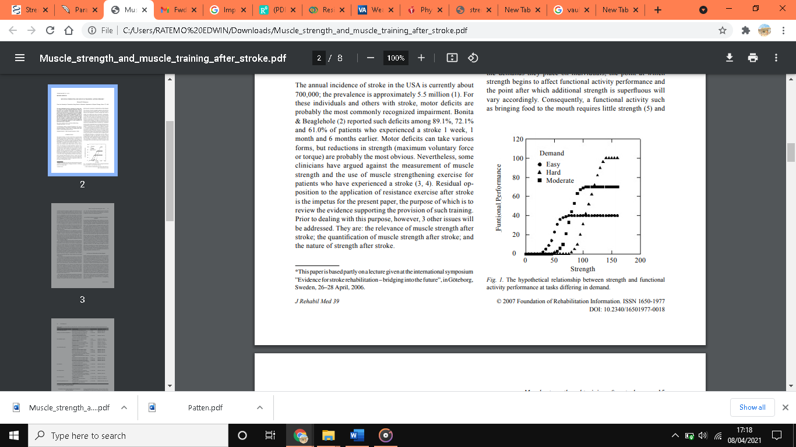
Two experiments have investigated the association between lower limb intensity and stair ascending success in acute and chronic stroke.
Both studies discovered substantial associations (58% – 85%) regarding paretic limb intensity and stair climbing efficiency (12.5, 18.5).
The analysis found no important associations between stair ascending velocity and intensity measurements from the lower non-paretic limb (–0.07–0.08).
Figure 1: Bohannon et al, (2007), Relationship between functional workout and strength

Slide 9
Other researchers argue that the strengthening programs successfully work on stroke patients.
Based on both realistic and mathematical expectations, it's predicted that practical behaviors can be improved by workouts.
Data showed no clear impact of strength exercise on recovery of control following stroke (Bohannon, (2007, p. 4).
Hand- and sit-to-to-stand and other similar movements are easier to perform so perform.
Such moves improves motor ability in older adults.
Regardless of the method of strength training, a patient can do more intense movements.
Deficits may affect the limbs other than the paretic ones.
Sufficient extant study has sought outpatients of various ages and abilities.
Before more studies are done, positive evidence can guide our encouragement in the usage of aerobic exercise during a stroke.

